Slide 1


Average ,Mixture and Alligation. Session No.: 02 Course Name: Professional Readiness Course Code: O1UA603L Instructor Name: Dharmendra kumar Duration: 50 min Date of Conduction of Class: 0

Slide 2
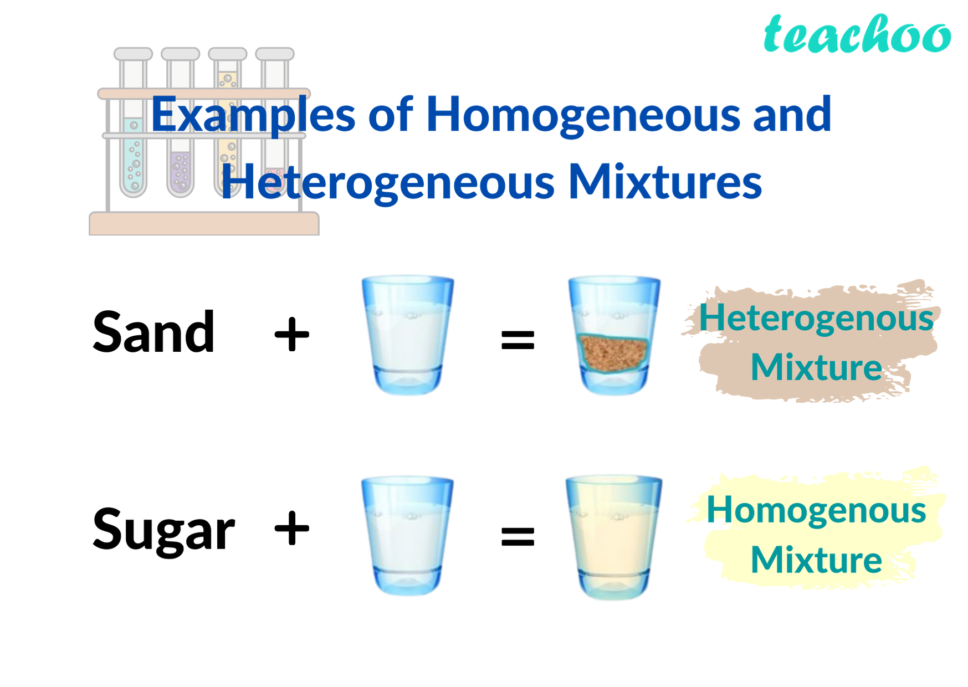

Slide 3
At the end of this session students will be able to
Learning Outcome 1: Analyse and Apply concepts to solve problems involving Averages and Mixtures..
Learning Outcome 2: strengthen problem-solving abilities through collaborative learning.

Slide 4
Session Outline
1 Quick “Think Pair Share” on prior knowledge.
2 Brainstorm real life example.
3 Group work on Average ,mixture and alligation
4 Solve & discuss word problems on average ,mixture and alligation
5 Summarize key takeaways.
6 Reinforce learning with quick recap.

Slide 5
Learning Activity 1
Activity encouraging:
Mind cognitive skills.
Mental Analytical skills
Peer Discussions
Easy understanding of concept

Slide 6
Students reflect on their teamwork and problem-solving skills while solving the questions.
They recognize the importance of Average ,mixture and alligation in real-world scenarios through discussion.
Encourages self-evaluation on how effectively they understood and applied concepts of average ,mixture and alligation.

Slide 7

Learning Activity 2

Slide 8
Q1. Average marks of the class X, Y & Z is calculated. The average score of class X, Y, Z are 83,76,85 and the number of students in the three classes are 27, 36 and 45 respectively. Find the average score of all the three classes. (a) 80 (b) 82 (c) 82.5 (d) 81.5

Slide 9
Q2. The average of 9 observations is 87. If the average of the first five observations is 79 and the average of the next three is 92. Find the 9th observation. (a) 118 (b) 112 (c) 102 (d) 115

Slide 10
Q3. The average of 7 numbers is 34 and the average of the first three numbers is 28 and the average of the next two numbers is 47. Find the average of the last two numbers. (a) 28 (b) 29 (c) 30 (d) 31

Slide 11
Q4. The average of 9 numbers is 79. The average of the first two numbers is 75. Also, the average of the next four numbers is 87. If the 8th number is five more than 7th number and one more than 9th number. Calculate 9th number. (a) 78 (b) 79 (c) 72 (d) 71

Slide 12
Q5. The average weight of A, B & C is 84 kg. If D joins, the average weight becomes 80 kg. If another person E who is 3 kg heavier than D replaces A, then the average weight of B, C, D and E becomes 79 kg. Find the weight of A? (a) 75 (b) 79 (c) 80 (d) 81

Slide 13
Q6. The average weight of four people A, B, C, D is 40 kg. If E is included then the average of A, B, C, D, E becomes 41 kg. If A is replaced by F then the average of B, C, D, E, F is 45 kg. Find the average of B, C, D, F. (a) 48 (b) 49 (c) 50 (d) 45

Slide 14
Q7. Three years ago, the average of a family of five members was 17 years. A baby having been born & the average age of the family is still the same today. Find the age of the child. (a) 1 (b) 1.5 (c) 2 (d) 2.5

Slide 15
Q8. There are 35 students in a hostel. If the number of students increased by 7, the expense of mess increased by Rs. 42 per day. While the average expenditure per head decreased by Rs. 1. Find the original expenditure of the mess? (a) 480 (b) 490 (c) 420 (d) 510

Slide 16
Q9. The average of 100 numbers is 46 but it was found that two numbers 16 & 43 are mistakenly calculated as 61 & 34. Find the correct average if it was found that the total number is only 90. (a) 48.7 (b) 49.8 (c) 50.7 (d) 51.5

Slide 17
Q10. A batsman has a certain average in his 11 innings. He scored 90 runs in 12th innings, due to this his average decreased by 5 runs. Find his current average. (a) 150 (b) 145 (c) 150 (d) 155

Slide 18
Q11. If the bowling average of a bowler is 12.4 runs per wicket. He took 10 wickets in his next innings by giving 52 runs; due to this his bowling average improved by 0.4 run per wicket. Find the total number of wickets taken by him at present?
(a) 170 (b) 180 (c) 190 (d) 200

Slide 19
Q12. The average age of a cricket team of 11 players is the same as it was 3 years back because three of the players whose current average age of 33 years are replaced by youngsters. The average age of the newcomers is?
(a) 22 (b) 24 (c) 26 (d) 28

Slide 20
Q13. The average weight of girls is 15 and the average weight of boys is 30 and the average weight of boys and girls both is 25. If the number of boys is 12, then the number of girls is?
(a) 4 (b) 6 (c) 10 (d) 18

Slide 21
Q14. The ratio of the number of girls to the number of boys is 1:2. If the average weight of the boys is 30 kg and the average weight of both the boys and the girls is 25 kg, then the average weight of the girls is?
(a) 20 (b) 16 (c) 15 (d) 30

Slide 22
Q15. Two varieties of milk with different prices are mixed in the ratio of 2:3. The price of the first type of milk is Rs. 10 per litre while the price of the second type of milk is Rs 15 per litre, respectively. The average price of the mixture (per litre) is?
(a) 12 (b) 13 (c) 14 (d) 15

Slide 23
Q16. 5 kg of superior quality of rice is mixed with 25 kg of inferior quality rice. The rice of superior quality and inferior quality rice is Rs 18 and Rs 12 respectively. The average price per kg of the mixture is?
(a) 13 (b) 15 (c) 18 (d) 21

Slide 24
Q17. 16 litres of wine is mixed with 5 litres of water. The price of wine is Rs 12 per litre and the price of water is Rs 33 per litre. The average price of the mixture per litre is?
(a) 15 (b) 17 (c) 23 (d) 27

Slide 25
Q18. In my big pocket there is Rs 25 consisting of only the denominations of 20 paise and 50 paise. Thus, there are a total of 80 coins in my pocket. The no. of coins of the denomination of 50 paise is?
(a) 20 (b) 25 (c) 30 (d) 35

Slide 26
Q19. There are some pigeons and sheep in a grazing field. The no. of total heads is 60 and total legs are 168 including both pigeons and sheep. The no. of sheep is?
(a) 24 (b) 36 (c) 44 (d) 30

Slide 27
Q20. A shopkeeper purchased two qualities of pulses at the rate of Rs. 200 per quintal and Rs. 260 per quintal. In 52 quintals of the second quality, how much pulse of the first quality should be mixed so that by selling the resulting mixture at Rs. 300 per quintal, he gains a profit of 25%?
(a) 52 (b) 44 (c) 26 (d) 30

Slide 28
Q21. A man purchased 5 horses and 10 cows of Rs. 10000. He sells the horses at 15% profit and cows at 10% loss. Find the cost of each horse if he earns a profit of Rs. 375.
(a) 2100 (b) 1100 (c) 1250 (d) 1200

Slide 29
Q22. The ratio of water and wine in two different containers is 2:3 and 4:5. In what ratio are we required to mix the mixture of two containers in order to get the new mixture in which the ratio of wine and water is 7:5?
(a) 7:3 (b) 5:3 (c) 8:5 (d) 2:7

Slide 30
Q23. In the 75 litres of mixture of soda and water, the ratio of soda and water is 4:1. The quantity of water required to make the ratio of soda and water 3:1 is?
(a) 10 (b) 15 (c) 5 (d) 12

Slide 31
Q24. A vessel is full of 80 Litres of milk, 8 litres taken out and replaced by water. Again 8 litres of mixture are taken out and replaced by water, find the amount of milk in the final mixture so formed?
(a) 24.5 (b) 36.4 (c) 44.8 (d) 64.8

Slide 32
Q25. A vessel is full of milk. 15 litres of milk are taken out and replaced by water. This process is repeated once more. Find the initial amount of milk in the vessel if at the end the ratio of milk to water becomes 16:9.
(a) 44 (b) 65 (c) 75 (d) 80

Slide 33
Reflection- Learning Activity 2
Students review appropriate solution approaches and discuss key takeaways.
They reflect on challenges faced and how they resolved them.
Builds confidence, problem-solving skills, and presentation abilities.

Slide 34
Summary

Slide 35
Outcome 1: Formula application of Averages and how to compute weighted averages
Outcome 2: Formula application, concept of mixtures, rule of alligation and replacement property.

Slide 36
Information about the next lesson

Slide 37
Review and Reflection from students

